Slide 1

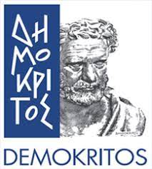
Multimodal Project Presentation
Audio fingerprinting
Authors: Gkatsis Vasilis Varsou Penny

Slide 2
Introduction
Audio fingerprinting is something that nowadays became more useful and useful in many different fields.
All the algorithms like shazam and etc. are close and cannot be used in order to develop more apps.
Github link: https://github.com/VarsouPenny/dejavu

Slide 3
Project consists the following steps
Download 5800 songs from youtube using Youtube-DLG app.
Convert all songs to monocanal using ffmpeg.
We run Dejavu fingerprinting and create three distinct databases with 5800, 1000, and 100 songs.
We run Dejavu recognize:
For different time queries (songs in disk).
For different time queries with various noise level (songs in disk).
For different time queries through microphone.

Slide 4
Dejavu library
An audio fingerprinting and recognition algorithm implemented in Python.
Can memorize an audio by listening to it and fingerprinting it.
Can recognize an recognize a songs by recording microphone input or reading from disk.
The above happens because it attempts to match the audio against the fingerprints held in database.

Slide 5
Dejavu library
An audio fingerprinting and recognition algorithm implemented in Python.
Can memorize an audio by listening to it and fingerprinting it.
Can recognize an recognize a songs by recording microphone input or reading from disk.
The above happens because it attempts to match the audio against the fingerprints held in database.

Slide 6
Dejavu library
An audio fingerprinting and recognition algorithm implemented in Python.
Can memorize an audio by listening to it and fingerprinting it.
Can recognize an recognize a songs by recording microphone input or reading from disk.
The above happens because it attempts to match the audio against the fingerprints held in database.

Slide 7
Songs
We try to include a variety of different kinds of songs in many languages.
We download them as mp3.
We convert them to monocanals.

Slide 8
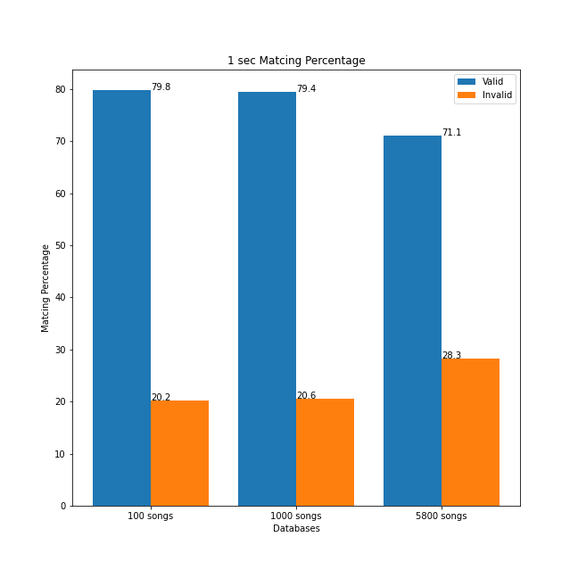
Integration test
We test evaluation and performance with different time queries in all databases
For 1 sec query:

Slide 9
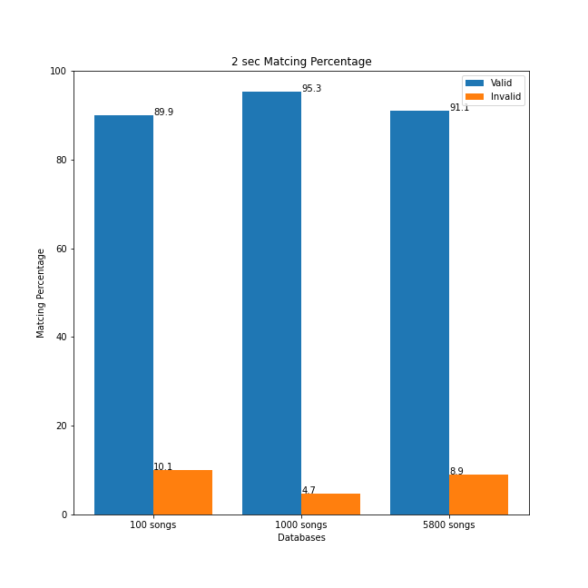
Integration test
We test evaluation and performance with different time queries in all databases
For 2 sec query:

Slide 10
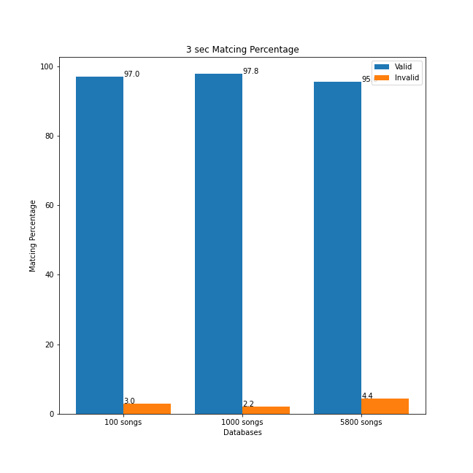
Integration test
We test evaluation and performance with different time queries in all databases
For 3 sec query:

Slide 11
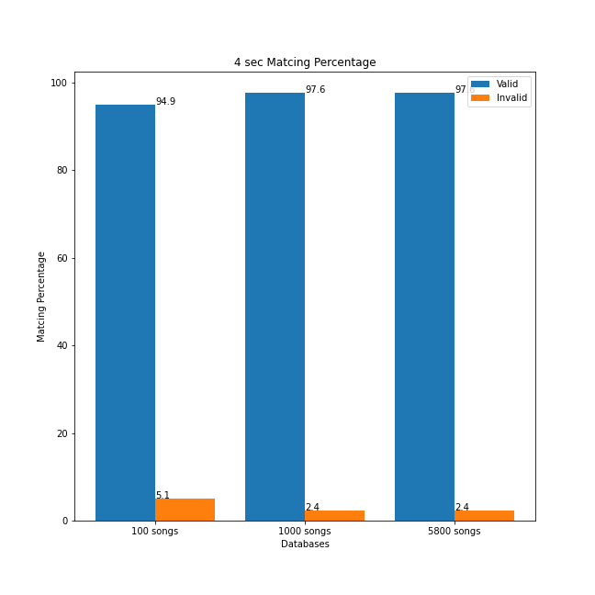
Integration test
We test evaluation and performance with different time queries in all databases
For 4 sec query:

Slide 12
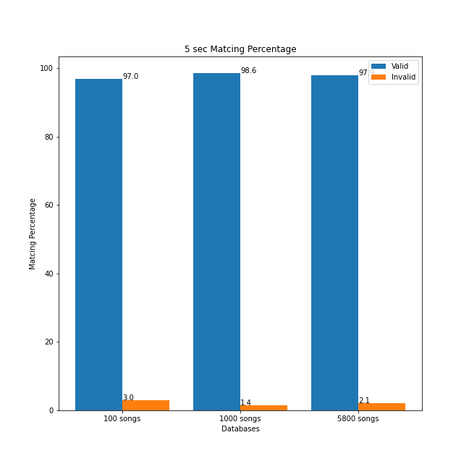
Integration test
We test evaluation and performance with different time queries in all databases
For 5 sec query:

Slide 13
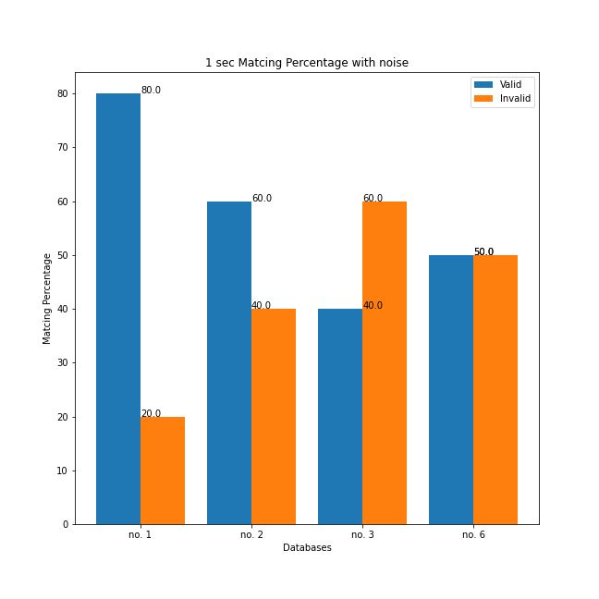
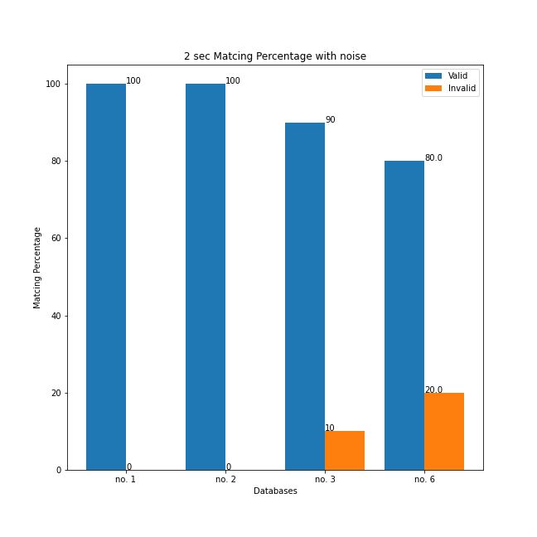
Integration test
Test evaluation and performance with different time queries and 4 distincts noise levels

Slide 14
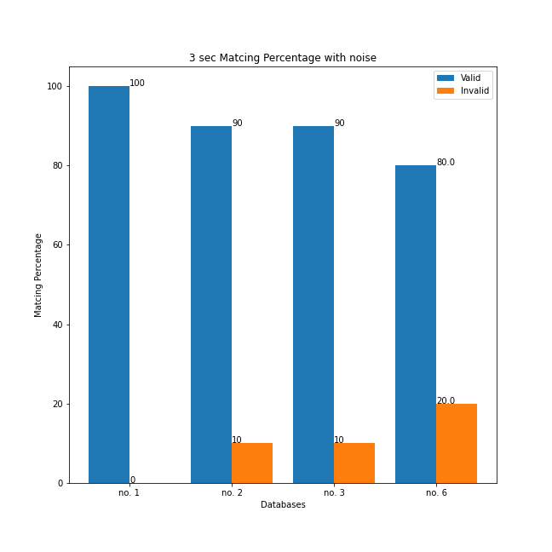
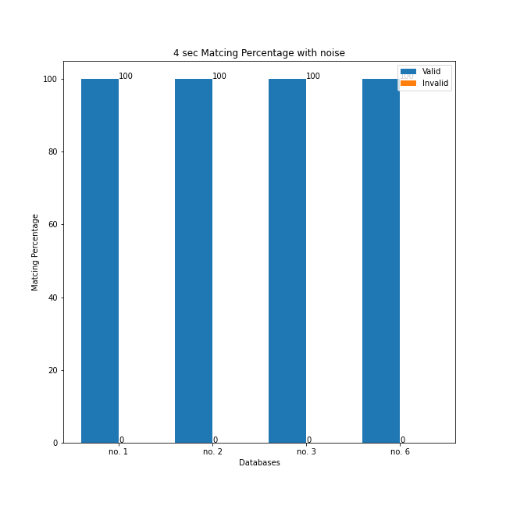
Integration test
Test evaluation and performance with diffent time queries and distinct noise level

Slide 15
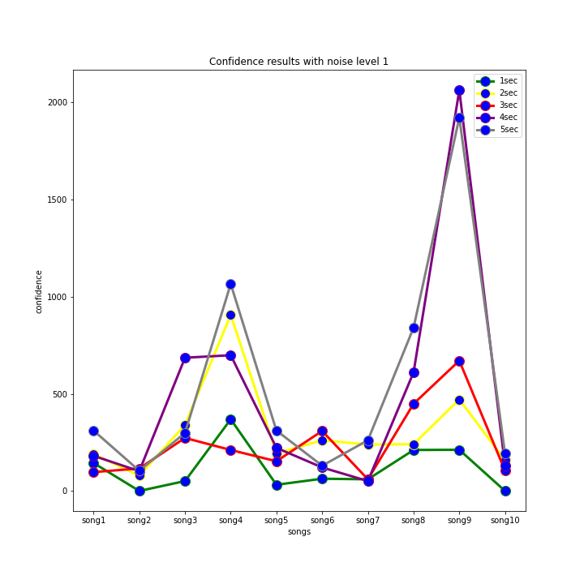
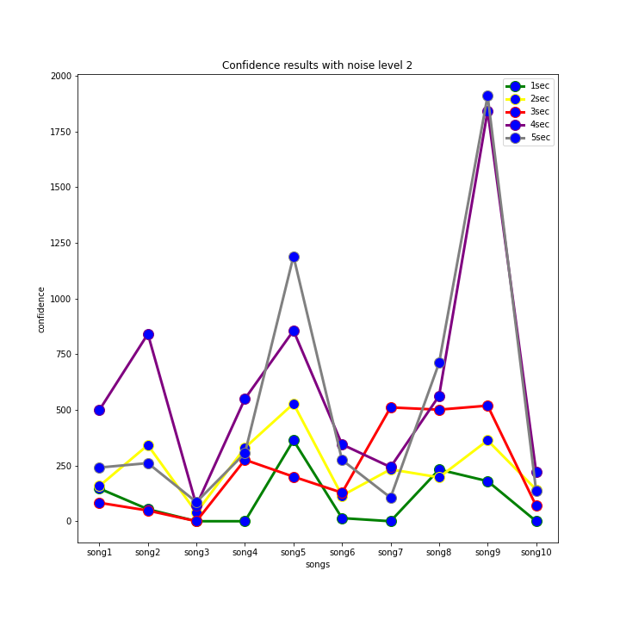
Integration test
We also make plots with the confidence that Dejavu replies each time

Slide 16
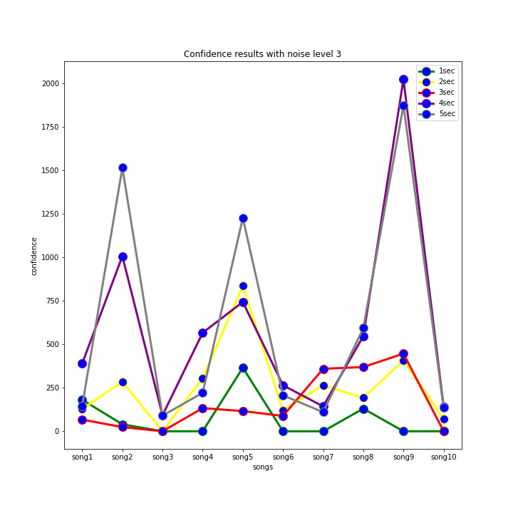
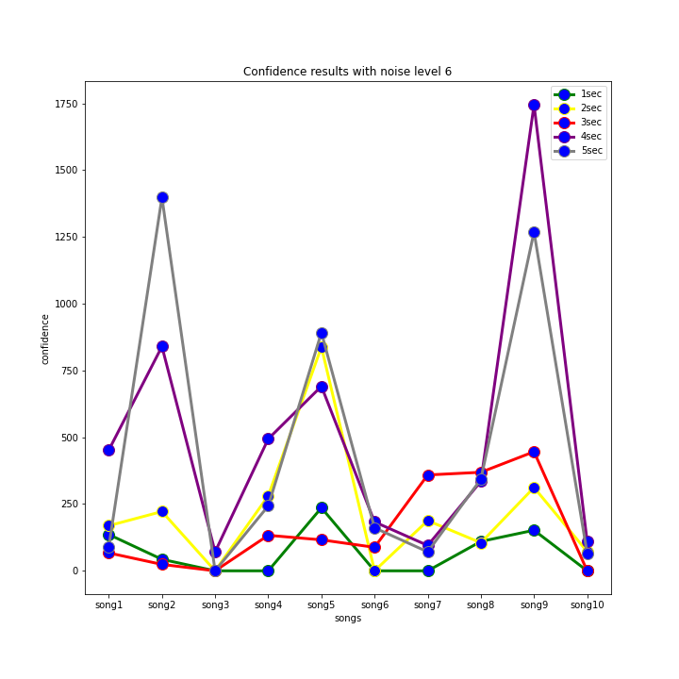
Integration test
We also make plots with the confidence that Dejavu replies each time

Slide 17
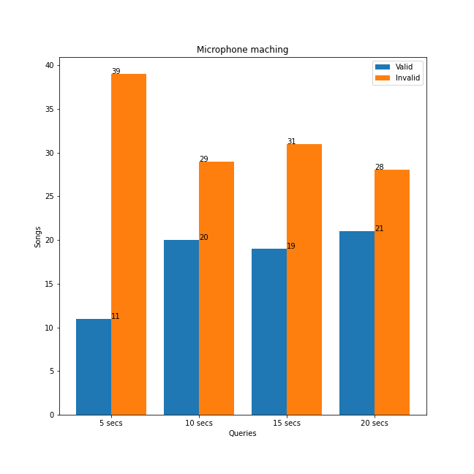
Integration test
Last but not least we test song recognition by recording microphone input .

Slide 18
Some conclutions
Dejavu is more sensitive to small time queries than in noise level.
For microphone recognition it depends on the amount of songs that database has and the part of song that is given as input to identify.

Slide 19
Future work
Try with more that 10k songs.
Calculate query duration in different databases and compare.
Calculate and compare confidence in different databases.

Slide 20
References
https://willdrevo.com/fingerprinting-and-audio-recognition-with-python/
A. Wang, “An industrial strength audio search algorithm.,” Jan 2003.
https://pypi.org/project/PyDejavu/
https://www.jesusninoc.com/02/06/dejavu-audio-fingerprinting-and-recognition-in-python/

